Slide 1
Beam Balance (PID)
By: Kevin Zhang, Rishab Kedia, Sitar Harel

Slide 2
Introduction
A beam with ball on it.
Sensors on either side measure position of the ball.
Goal is to keep the ball in the center of the beam balance(if it were to veer off, correct the error using the most efficient method)
Combines computer science, robotics, and calculus

Slide 3
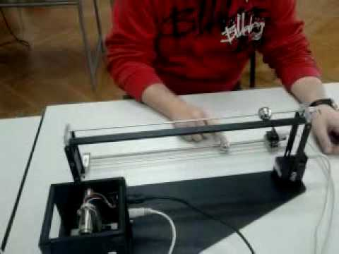
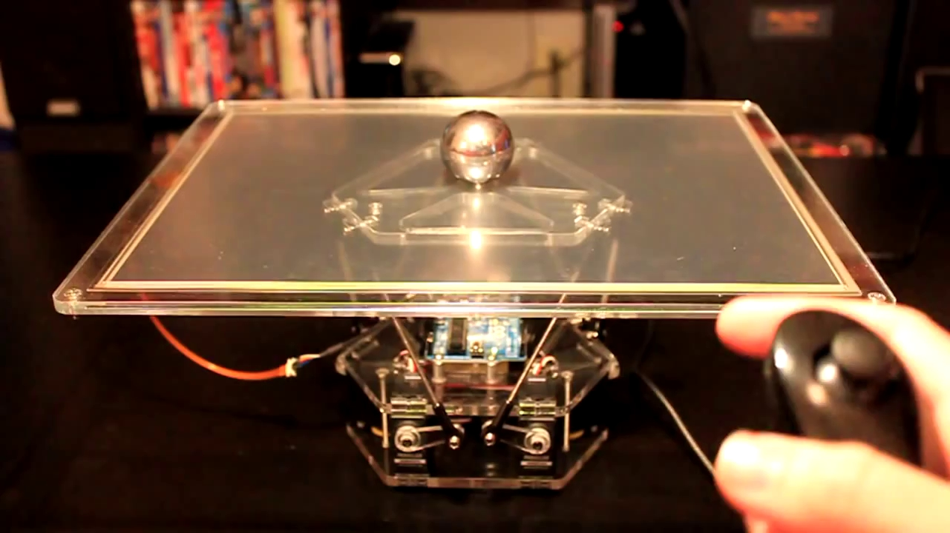
Super Cool Examples

Slide 4
Demo
PID Control Vid
PID Control 2.0
PID Control 3.0
Github.com Code
https://github.com/kevjumba/PID-Control-Beam-Balance
Two folders hold the real code BalancePID and BeamBalanceGraph
The other folder is our initial attempt of code that didn’t work after hours and hours of suffering.

Slide 5
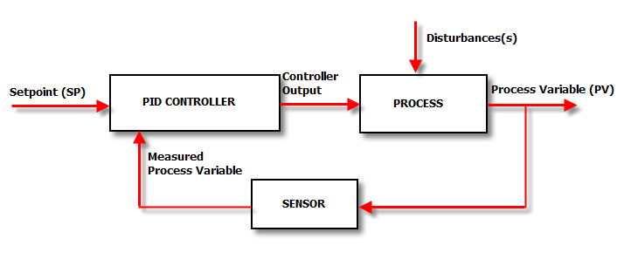
Control Feedback Loop
A control feedback loop is a computer algorithm that feeds information to a central processing unit in a loop.
Our program analyzes error and feeds it back into the program to be used in the next loop.

Slide 6
Error
“Zero” error or the setpoint, is the position we want
error is the distance from the setpoint
Loop is run many times a second to calculate the error.
Error is used to return ball back to center of beam balance

Slide 7
Proportional Error Adjustment
Takes error, uses constant coefficient to determine output to motors
It adjusts motors based on the magnitude of the error
However, only adjusting motors based on the magnitude will only cause the ball to oscillate around the center point.

Slide 8
Calculus
Derivative
This shows how fast the error is changing. Using this we can predict(assuming the error changes at the same speed) where it will be in some time.
if the speed is high approaching a target, the derivative slows it down and vice versa.

Slide 9
Calculus Continued
Integral(literally means sum):
Summation of errors in past time intervals.
Used to provide one portion of the weighted average that determines motor speed
If a ball is at a position for too long, the integral or sum will add up the errors and rev the motors up to overcome the friction or other force.
Might cause slight overshoot but the graph will eventually asymptotically approach the target.
Note: In our project, integral isn’t extremely needed since friction is not enough to overcome it but in real life, integral is very useful.

Slide 10
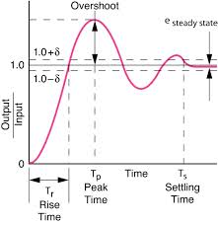

Slide 11
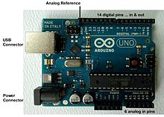
Electronics
The arduino uno is a microcontroller used for many robotics tasks such as this one.
The ping ultrasonic sensor uses sonic waves and gets the return signal.

Slide 12
Graphing
Connects Arduino and Processing through a serial port on the computer
Processing creates a PApplet that reads values through the same port
When our program is run, it sends streams of data to the serial port that is read from the processing side and outputted on the PApplet window

Slide 13
Pseudocode
PID algorithm
Take in a position that is read and interpreted from the ultrasonic sensor
calculate magnitude of error by subtracting ( target - input)
calculate integral ( or sum) by adding error to global sum
calculate slope by subtracting current error by last error
add all of these values each multiplied by a constant
return
Loop
Calculate distance
calculate pid value
send it to servo

Slide 14
Pseudocode
Calculate distance (use of sensor is documented online)
if one of the sensors is bad use other sensor and set state accordingly
calculate error differently and set motors differently for each state

Slide 15
Challenges
One of the largest obstacles is sensor inaccuracy.
Tried many different solutions to filter out inaccurate data and use accurate data.
Best one uses two states: Reverse and Direct (determines and uses sensor that appears to be working regularly, not one that has outlier value)
PID algorithm is different than the conventional
Beam Balance
Using Servos
PID algorithm is too sensitive because our sensors are not accurate enough. This means that our contraption oscillates and jerks even after it has hit the position.

